Slide 1
Enhancing User Experience and Business success with Recommendation Systems
Presented by: -
Shivam Kumar
MITU22MCAD0096

Slide 2
Introduction
A recommender system, also known as a recommendation system, is a subclass of information filtering systems that seeks to predict the “rating” or “preference” a user would give to an item.
Recommender systems are used in playlist generators for video and music services, product recommenders for online stores, content recommenders for social media platforms, and in many other areas. These systems operate by gathering data on users’ past behavior, such as purchasing history or watched videos, and use that information to calculate a prediction of what they may have an interest in in the future.
There are several algorithms that can be used to build recommender systems, such as collaborative filtering, content-based filtering, and hybrid systems that combine both methods. The goal of a recommender system is to personalize the user experience by providing highly relevant and useful recommendations.
Eg: In the case of Netflix which movie to watch, In the case of e-commerce which product to buy, or In the case of kindle which book to read, etc.

Slide 3
Use Cases of Recommendation Systems
1. eCommerce Recommendations
2. Media Recommendations
3. Video Games and Stores
4. Location-Based Recommendations
5. Health and Fitness
6. Social media
7. Finance
8. Advertising
9. Education
And many more…

Slide 4
Types of Recommendation Systems
Recommender System is of different types:
Content-Based Recommendation: It is supervised machine learning used to induce a classifier to discriminate between interesting and uninteresting items for the user.
Collaborative Filtering: Collaborative Filtering recommends items based on similarity measures between users and/or items. The basic assumption behind the algorithm is that users with similar interests have common preferences.

Slide 5
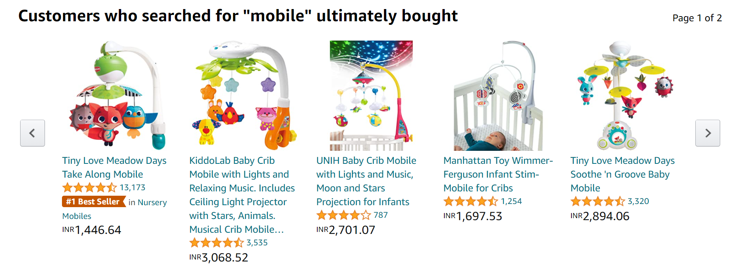
Collaborative Based Filtering
Recommending the new items to users based on the interest and preference of other similar users is basically collaborative-based filtering. For eg:- When we shop on Amazon it recommends new products saying “Customer who brought this also brought” as shown below.
There are 2 types of collaborative filtering:-
User-Based Collaborative Filtering
Rating of the item is done using the rating of neighboring users. In simple words, It is based on the notion of users’ similarity.
Item-Based Collaborative Filtering
The rating of the item is predicted using the user’s own rating on neighboring items. In simple words, it is based on the notion of item similarity.

Slide 6
Content-Based Recommendation (Entertainment)
Content-based systems recommend items to the customer similar to previously high-rated items by the customer. It uses the features and properties of the item. From these properties, it can calculate the similarity between the items.
Item Profile
In a content-based recommendation system, we need to build a profile for each item, which contains the important properties of each item. For Example, If the movie is an item, then its actors, director, release year, and genre are its important properties.
For the document, the important property is the type of content and set of important words in it.

Slide 7
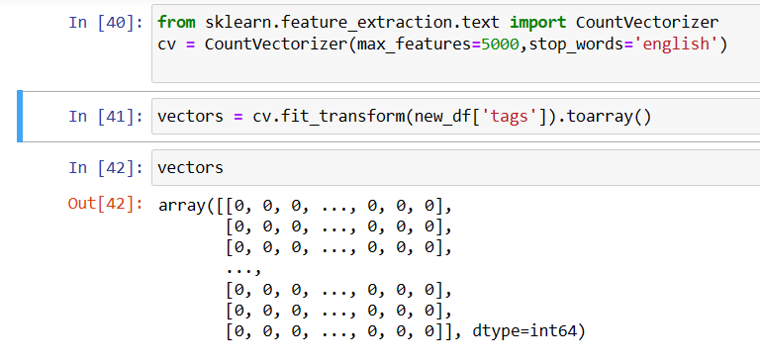
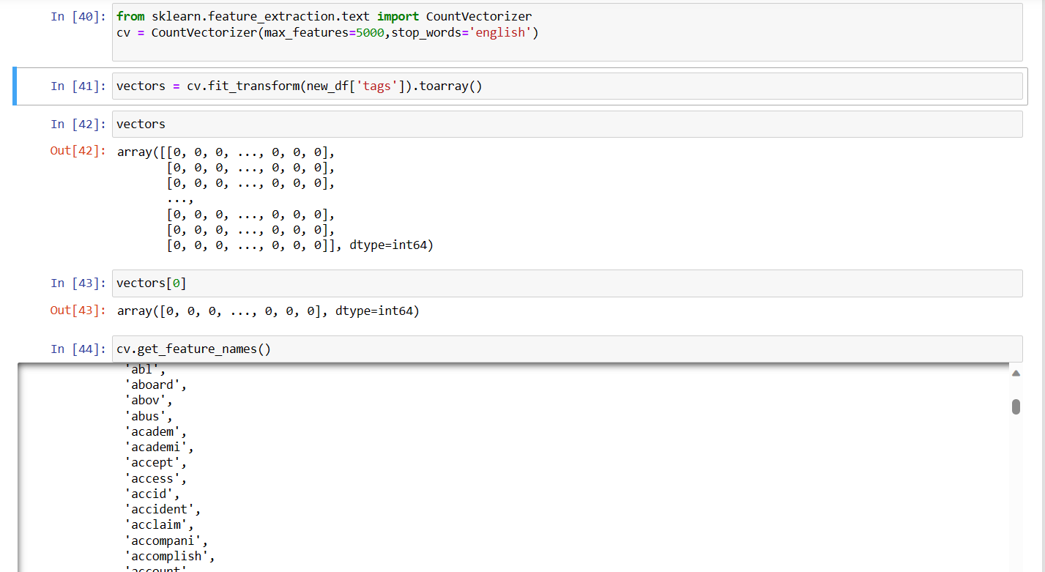
TF-IDF Vectorizer
Term Frequency(TF)
Term frequency, or TF for short, is a key idea in information retrieval and natural language processing. It displays the regularity with which a certain term or word occurs in a text corpus or document. TF is used to rank terms in a document according to their relative value or significance.
Inverse Document Frequency – idf
The main purpose of doing a search is to find out relevant documents matching the query.

Slide 8
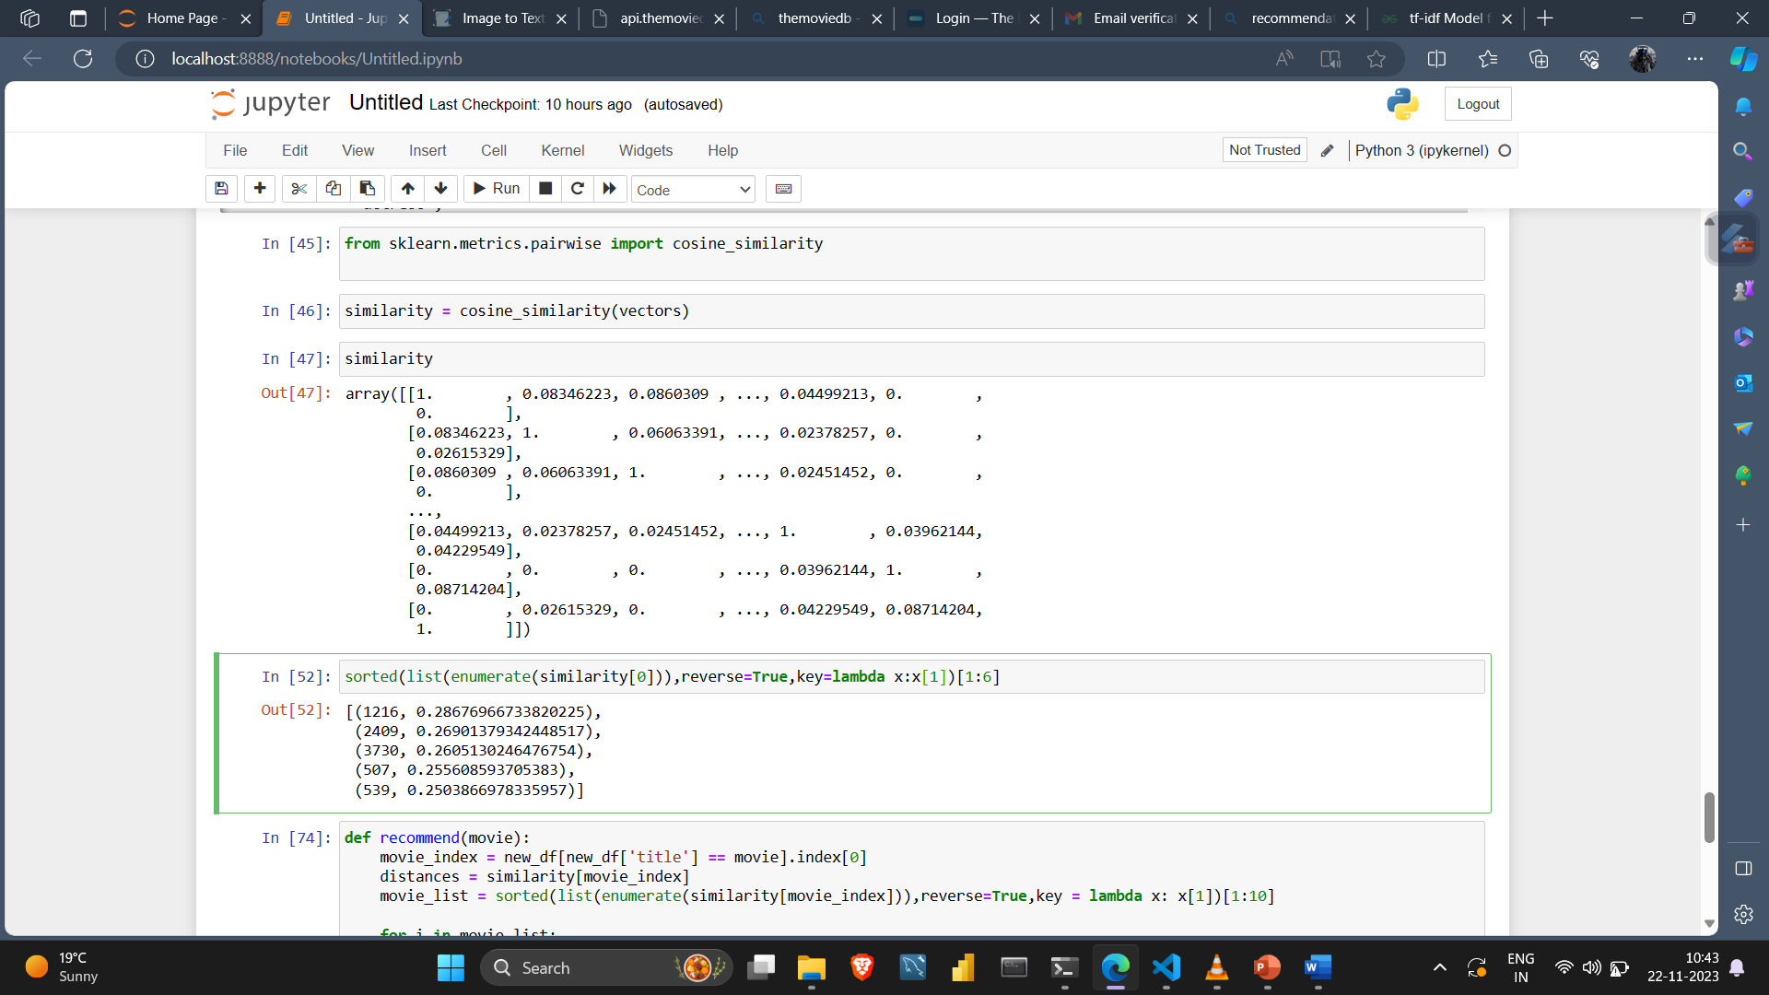
Scoring
We will use any of the similarity measures ( Cosine Similarity method) to find the similarity between the query and each document.

Slide 9
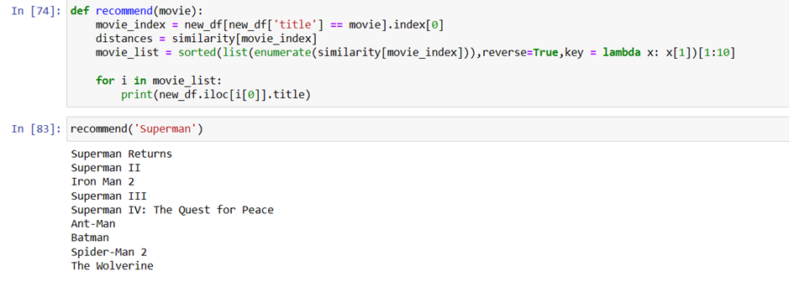
Recommendation from list of movies
On the basic of the tag of a movie the recommendation function will filter out the similar movie, the vector of each movie will be compare and the similar movie with the title will be displayed.
Here we have displayed top 10 similar movies

Slide 10
Advantage
Model doesn’t need data of other users since recommendations are specific to a single user.
It makes it easier to scale to a large number of users.
The model can Capture the specific Interests of the user and can recommend items that very few other users are interested in.
Disadvantage
Feature representation of items is hand-engineered to some extent, this tech requires a lot of domain knowledge.
The model can only make recommendations based on the existing interest of a user. In other words, the model has limited ability to expand on the user’s existing interests.

Slide 11
Thank You

